Slide 1
What’s Happening “Out There?”
Greater New Orleans Business Roundtable
March 2015
Vincent DiVita

Slide 2
Agenda
1
Objectives and Ground Rules
2
A Recap – until October 2014
3
And What Does it Mean?
  - Methane
  - Ethane
  - Propane
  - Refining
4
Impact of Oil Price Drop

Slide 3
Objectives and Ground Rules
Objectives
  To provide background regarding the “building boom” in petrochemicals (prices, demands, market & global forces)
  To discuss some trends and actual projects that we see in the market
  To discuss $50-60/B Oil impact
Ground Rules
  Public Information Only

Slide 4
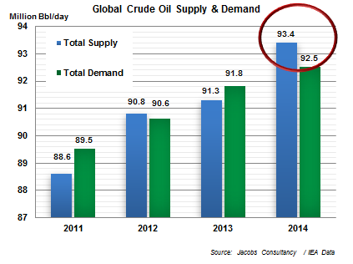
What’s Going on with Oil
GLOBAL CRUDE PRICES PLUMMETED AT THE END OF 2014
INCREASED US PRODUCTION
$
LIBYA’S PRODUCTION RETURNED
2015
LARGE VOLUMES OF CRUDE IN STORAGE IN THE US
$
TEHRAN’S NUCLEAR PROGRAM: 1 MMBPD MORE OF IRANIAN CRUDE
$
POSSIBLY

Slide 5
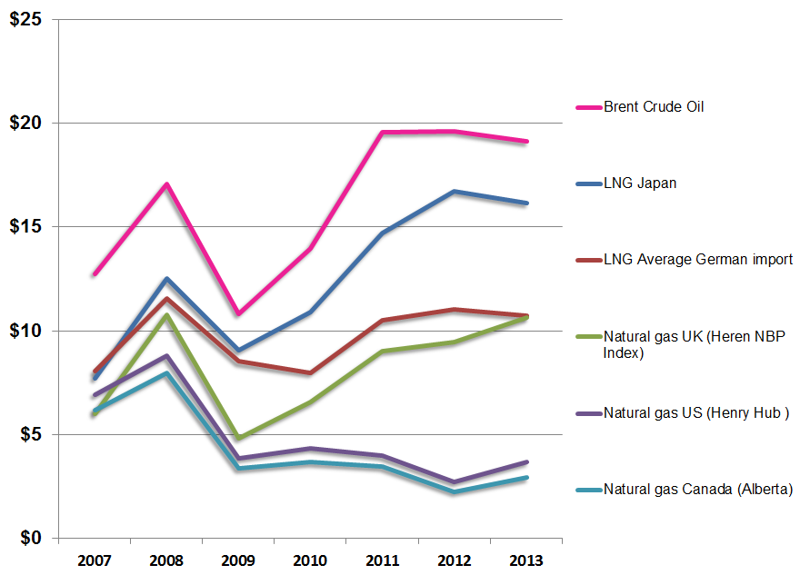
Natural Gas Price History (Global)
BENCHMARK NATURAL GAS HUBS TOGETHER WITH
CONTRACTED PIPELINE AND LNG IMPORTS
Contract Prices represented by LNG imports into Japan and average German import prices
Benchmark hub prices: US (Henry Hub), Canada (Alberta) and UK (NBP)

Slide 6
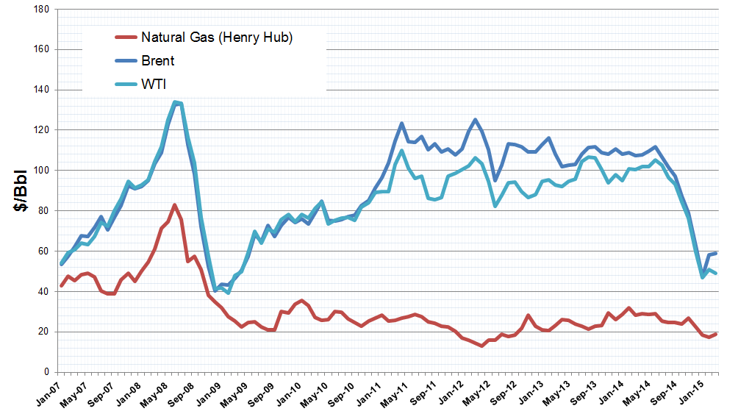
Historical Natural Gas Pricing (North America)
Historically, there was a strong correlation between oil and natural gas prices. With the rapid development of shale gas, this relationship ceased in North America
Most striking is oil price plummet is a “blip” on natural gas price
Natural Gas converted to equivalent FOEB

Slide 7
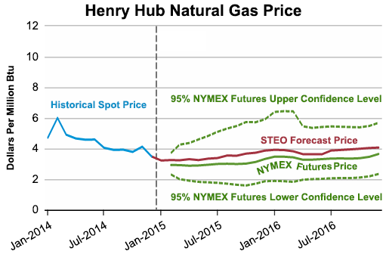
EIA Price Forecast, Base Case
Modest long term price increase, but still low compared to $100 crude ($5/MMBTU ~ $30/FOEB) (multiply by ~ 6). Gas at $50 crude is different story.
Short term price forecast lacks strong confidence.
Long Term: Updated when Oil was over $100/Bbl
Short Term: Updated January 2015
Annual Avg. Henry Hub Spot Price Forecast
$/MMBTU 2012 $
Source: EIA, 2014 AEO
Source: EIA, STEO

Slide 8
Methane/Natural Gas Projects
Today’s focus: Natural Gas, Methanol, Ammonia, GTL, LNG
Economics to keep in mind: Feedstock Costs & Product Revenues
Natural Gas
LNG
Syngas
GTL
Methanol
Hydrogen
Gasoline
Ammonia
Olefins(MTO)

Slide 9
US Market - Methanol
US Demand in 2013 was about 7 MMTPA.
About 5 MMTPA was imported.
The plants that are clearly underway (Celanese, Methanex relocations and expansions) will replace much of the import.
Room for one more before we become net exporter.

Slide 10
Methanol Market Situation
Global
Global Market Demand is about 60 MMTPA.
Global Capacity is about 100 MMTPA, but about 40 MMTPA is coal based in China, mostly shut down.
China
Chinese strategy is diversification of supply & weaning off coal
The Chinese plants are to export methanol to China to make plastic and fuel. Some have “issues”, but one or two may get built.

Slide 11
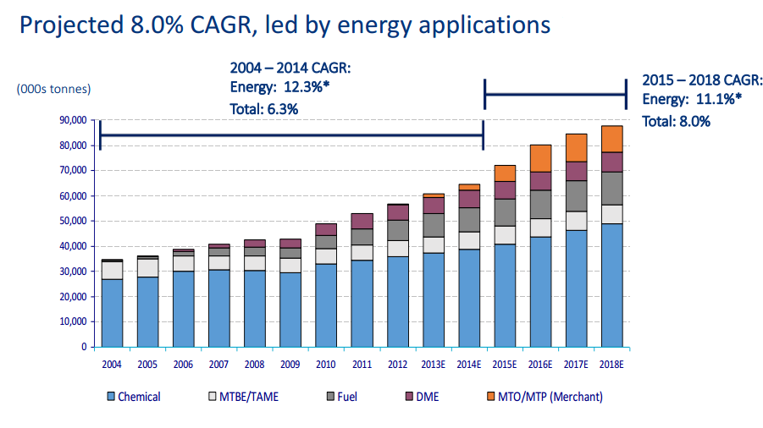
Methanol Demand Forecast
Source: Methanex Corporation, 2015

Slide 12

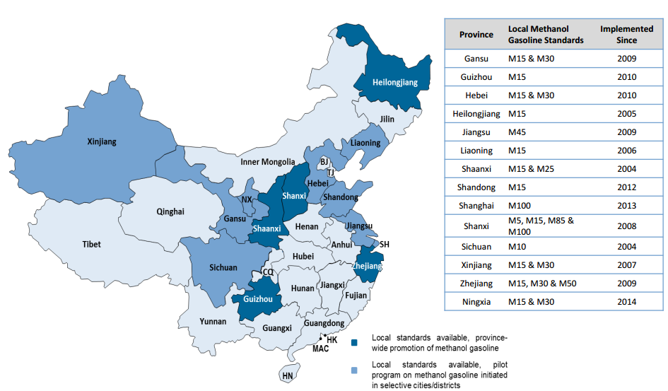
Methanol as Motor Fuel in China
Source: Methanex Corporation, 2015

Slide 13
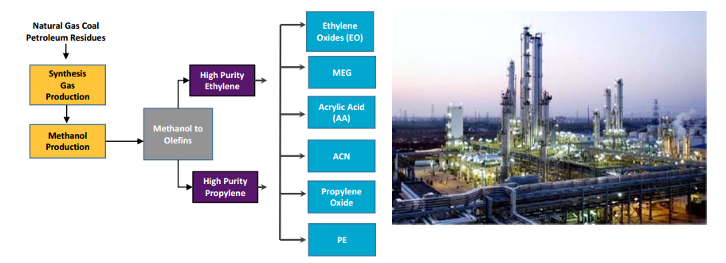
Methanol to Olefins (MTO)
Derivatives
Source: Methanex Corporation, 2015

Slide 14
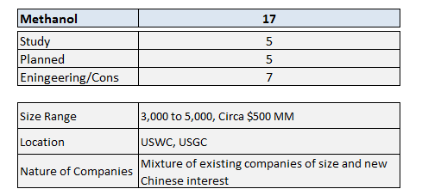
US Methanol Projects
Driven by foreign interest, led by Chinese. Use cheap US gas, produce methanol and ship to supply emerging market demands

Slide 15
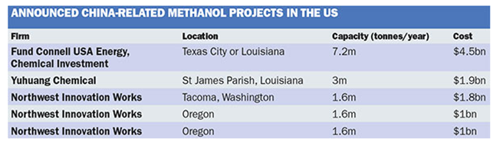
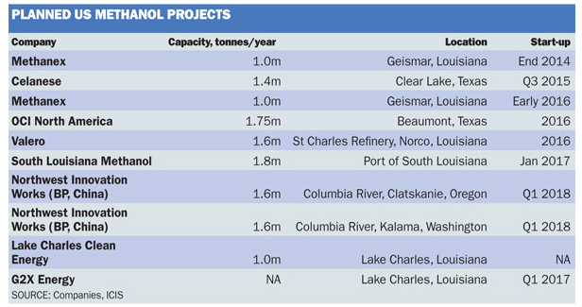
US Methanol Projects
Mega-Mega Methanol project driven by the production of plastics and other chemicals in China
Source: ICIS, 2014

Slide 16
Ammonia Market
US Demand is 21 MMTPA
Import (2013) was about 6 MM – 6 to 8 new plants equivalent
These projects are more fundamentally based (local demand centers)
There are several real projects underway, but some of the announced projects probably lack capital.

Slide 17
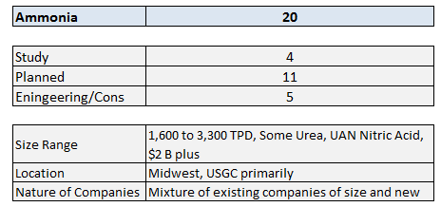
Ammonia
Also natural gas based, several in La.

Slide 18
GTL Projects
Shell/Sasol
These are in excess of 100,000 BPD of product
A host of other small/new technology announcements
The “bet” is on a high oil/natural gas price differential. This has collapsed.
If 150,000 B cost $20 B, I need $60 difference to get 15% ROI, not including op costs
On Jan. 28, 2015, Sasol announced that it was “delaying final investment decision on its proposed large-scale, US gas-to-liquids project to conserve cash in response to lower international oil prices”.
Shell ?

Slide 19
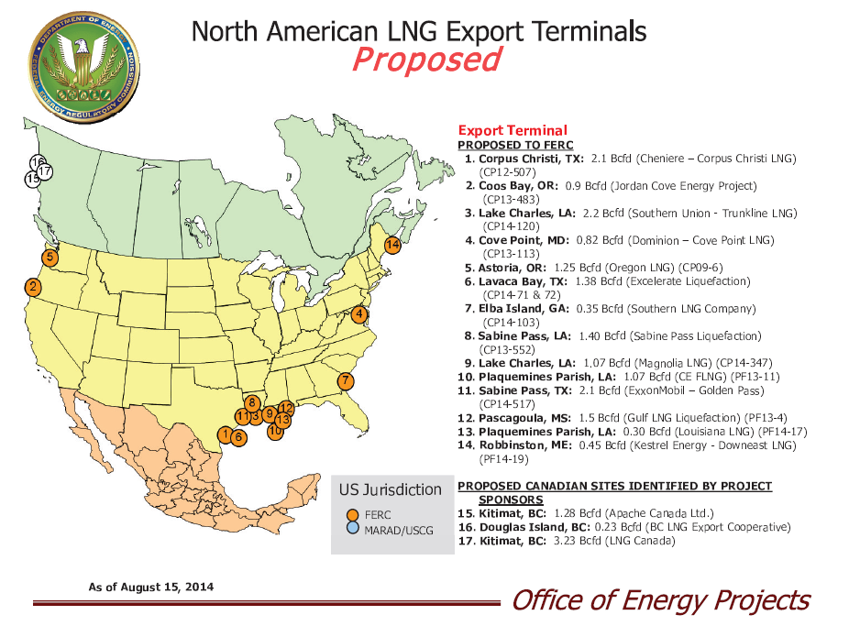
LNG – there are about 30 projects

Slide 20
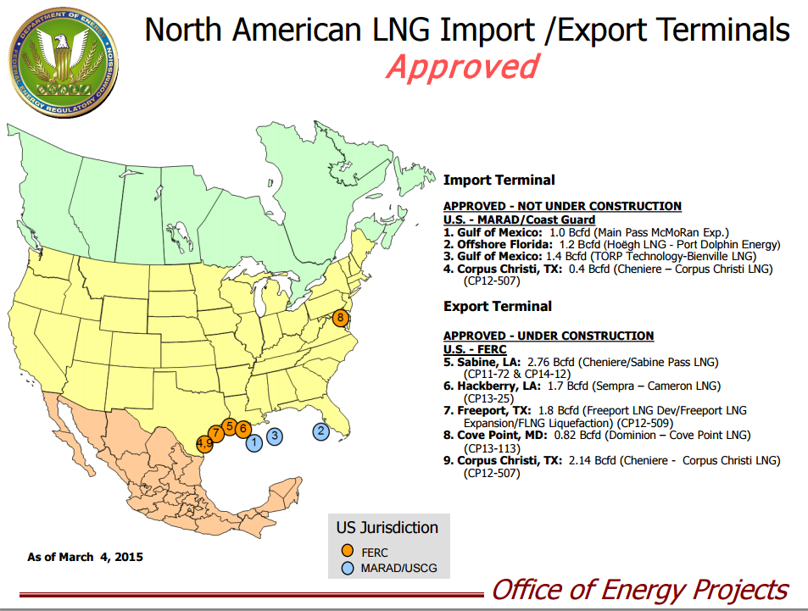
LNG- Approved Projects

Slide 21
LNG Export Issues
A 1.0 BCFD liquefaction plant will cost about $4 billion.
A spread of about $5/MMBTU is about the minimum differential between buying price and average selling price is required for a period of about 10 years.
The selling price in premium markets is tied to oil (diesel)
Long-term buy/sell contracts needed for financing
There is some political risk
Import terminals cost about $1 billion for 1 BCFD
Very long – 4 yr plus -- permit period
Deep pockets and strong is required

Slide 22
Ethane and Ethylene

Slide 23
How does the world make ethylene?
Saudi – Mostly ethane, but now mostly committed
Kuwait – Ethane, but not much left
Qatar -- Ethane
Europe – Naphtha and Gas Oil
South America, Mexico – Naphtha
FSU – Mostly Naphtha
India and China – Naphtha
And in the US
  Dominated by ethane ~70%, but also propane, butane naphtha

Slide 24
Ethane Value on $/MM Btu Basis Has Dropped
$/MM BTU of Marker Crude, Natural Gas & Ethane
Brent & Ethane Purity converted to $/MM BTU basis
Source: Jacobs Consultancy

Slide 25
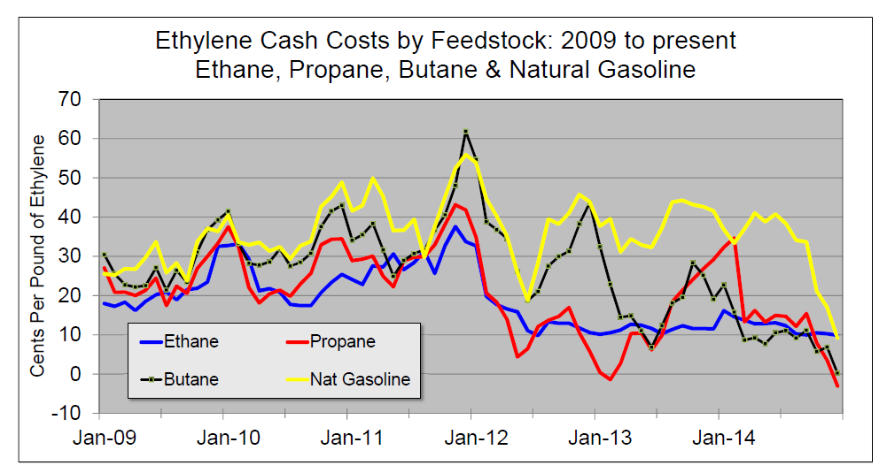
Ethylene Cost with by product credits
Historically, no feed had big advantage
Now, ethane and does, propane can be exported
Naphtha feed (co-products tied crude) is disadvantaged

Slide 26
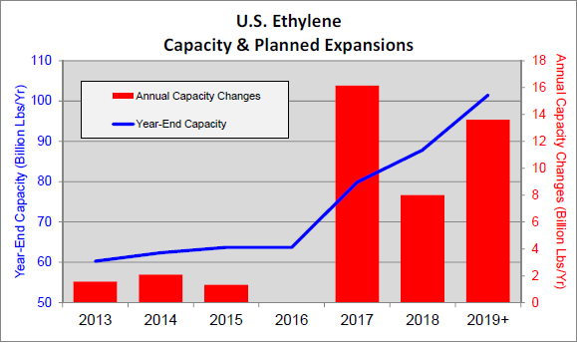
Cracker Projects – all on ethane
About 10 Projects, 4 to 5 in engineering

Slide 27
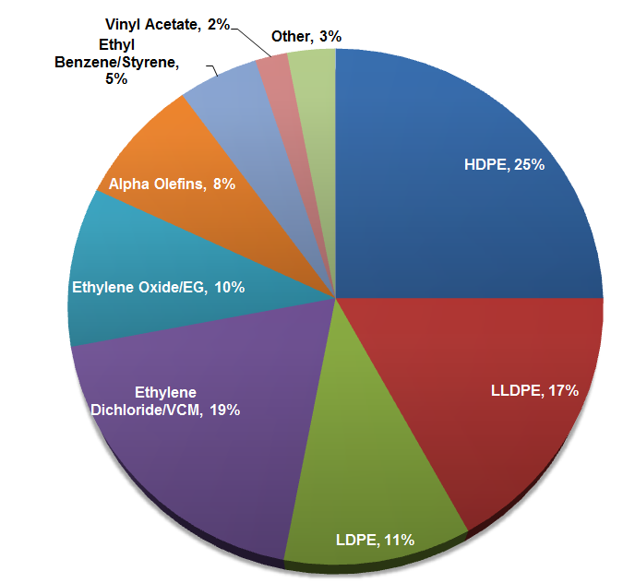
And what do you do with ethylene?
Ethylene is not exported. These derivatives are “physically” tied to the cracker at the site
Majority of ethylene goes to polyethylene

Slide 28
Here’s the “bet” for Ethane Crackers
Part 1 – That the price of natural gas will stay low relative to crude
Part 2 – That ethane supply will remain sufficiently long to price versus natural gas plus extraction
Part 3 – That crude will remain relatively high
Part 4 – That this will stay in place for about 15 years, minimum
Part 5 – that shale gas is not a big play elsewhere, especially China
Because – if this happens, I can make cheap PE from ethane here, land PE in China, where they use naphtha, sell versus their local PE and keep the profit.
Cost to play -- $5 to $10 Billion per project

Slide 29
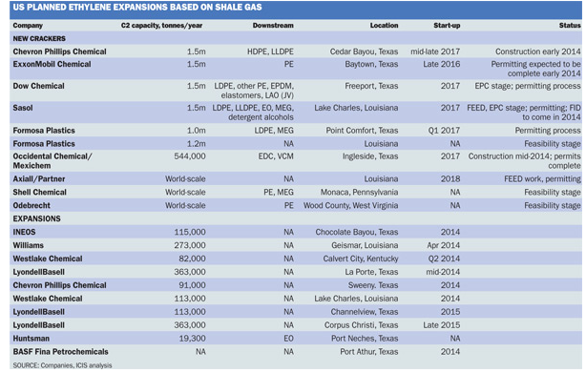
US Planned Ethylene Expansions
Source: ICIS, 2014

Slide 30
The Challenges
Construction Resources are being “pulled” by oil and gas production projects at $100 oil. With price drop, maybe less; with sustained price drop likely to see movements from E&P to chemicals.
The workforce is aging
It has been a long time since we needed this many specialized people – where are they?
High interest in module or skid mounted construction
  Need more commercial demonstrations
  Lower economies of scale, but potentially lower feedstock can be attractively sourced

Slide 31
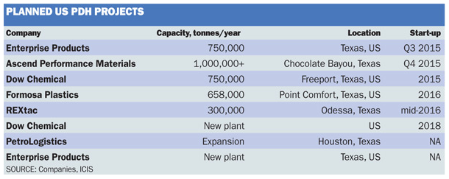
Propane
Propane is easily exported so the price does not “disconnect” from world prices as much as natural gas or ethane
Nonetheless, we are now an exporter (we weren’t three years ago), so domestic prices have some advantage.
Propylene prices are high domestically (ethane crackers do not make propylene)
There are 4 to 5 announced projects to build propane dehydrogenation units (PDH). About $600 MM each
Source: ICIS, 2014

Slide 32
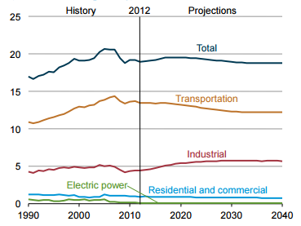
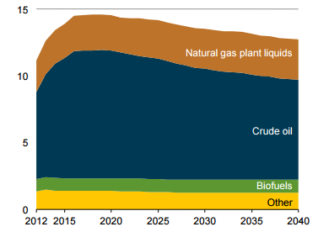
How About Refining?
US demand on left: US Production on right.
MMBPD
MMBPD
Source: EIA Annual Energy Outlook, 2014

Slide 33
Refining Projects
Little to negative domestic demand growth for refined products
Product can be exported, crude (by law) is more difficult.
A number of “refining light” projects underway and or planned to minimally process the light crude and export it
Reduced capital spending for nonessential projects
Regulatory projects
Niche projects in “insulated” areas (not USGC)
It is not the boom as in ethylene

Slide 34
On Oil Price Forecasting
Questions being asked: 1) Did crude price bottom, 2) What is the forecast?
The accurate answer is “We don’t know” – in fact no one can accurately predict short term oil price. The reasons are:
  Short term demand for refined product is very inelastic. On supply side, a 2% increase in gasoline supply will drop price by 20%.
  Prior to 1973, it was the Texas Railroad Commission prior to 1973, OPEC supposedly after
  Saudi and Kuwait have taken most of the production swing, but they are now interested in holding market share.
  At this point, high priced production (primarily US and Canada, but includes Brazil, Colombia) needs to erode and/or demand needs to grow to rebalance. Both will take time. No one really know how long.
  There are numerous other variables and uncertainties that can, arguably, push prices either way

Slide 35
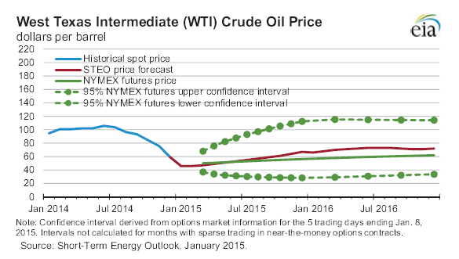
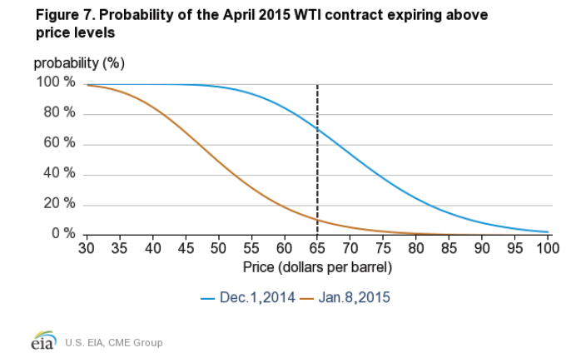
EIA Short Term Outlook
This figure shows that EIA thinks oil has bottomed and will gradually improve. However, the futures market confidence intervals are very high.
This figure shows market derived probabilities for April 2015 contracts. This is another way of saying that the market does not know. Note the drop in confidence since December.
Neither the EIA nor the NYMEX has historically been a good predictor of oil prices. However, they are no less accurate than any other source, in our opinion.

Slide 36
Other Energy Industries
Canada
  Canadian heavy oil production will stay relatively constant, but new projects are unlikely
  Look for cuts in all non essential spending
Biofuels
  Low oil prices hurt biofuels, especially ethanol and biodiesel
Natural Gas.
  On one side, natural gas and midstream activity could slow since the economics of many gas fields depend on co-produced light oil.
  However, less shale gas lowers overall supply and supports prices

Slide 37
Thanks for Your Attention
Questions?

Slide 38
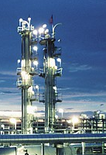
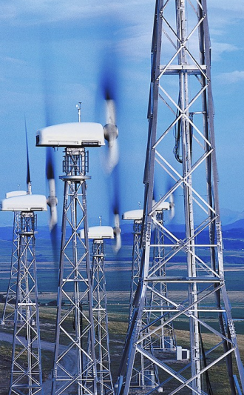
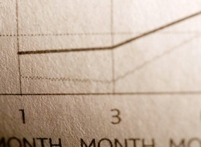
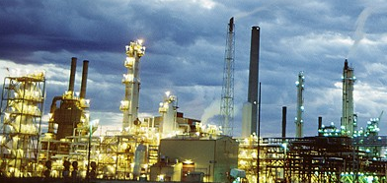
Contacts
United States Offices:
5995 Rogerdale Road
Houston, Texas 77072
832.351.7800 (phone)
832.351.7887 (fax)
525 West Monroe
Suite 1350
Chicago, Illinois 60661
312.655.9207 (phone)
312.655.9706 (fax)
Canada Office:
205 Quarry Park Boulevard SE
Calgary, Alberta T2C 3E7 Canada
403.258.6896 (phone)
403.385.1543 (fax)
United Kingdom Office:
Tower Bridge Court
226 Tower Bridge Road
London SE1 2UP
United Kingdom
+44 (0)20 7403 3330 (phone)
+44 (0)20 7089 7750 (fax)
China Office:
6F South Tower B, China Diamond Exchange Center
1701 Century Avenue, Pudong New District
Shanghai 200122
P. R. China
Tel; +86 21 5081 8811 * 607
Fax: +86 21 5081 6006
Netherlands Office:
Plesmanlaan 100, 2332 CB Leiden
P.O. Box 141, 2300 AC Leiden
The Netherlands
+31.71.582.7111 (phone)
+31.71.582.7050 (fax)

